Slide 1

Data Structure
Level 1
Big O(Log n) : Logarithmic Time Function

Slide 2

Data Structure
Level 1
Complexity of an Algorithm
Big O
O(Log n)
2

Slide 3
Data Structure
Level 1
What do we mean by log?
2

Slide 4
What do we mean by log?
x^2 → double itself
Log2 → half itself

Slide 5
Data Structure
Level 1
Calculating Algorithm Complexity
O(Log n)
2

Slide 6
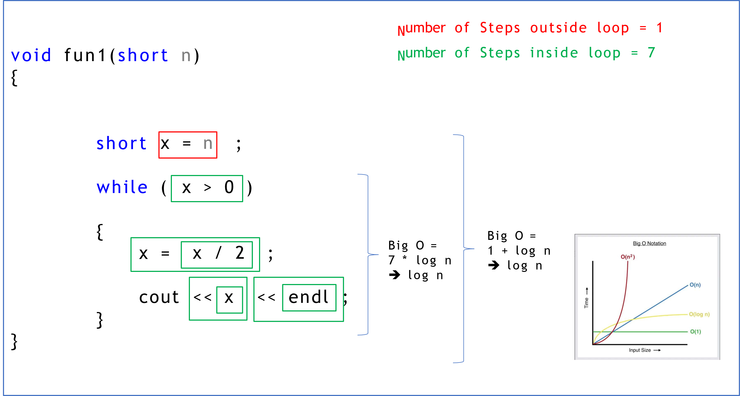
Calculating Algorithm Complexity:
Depends on n size, and relation is logarithmic Time Function.

Slide 7
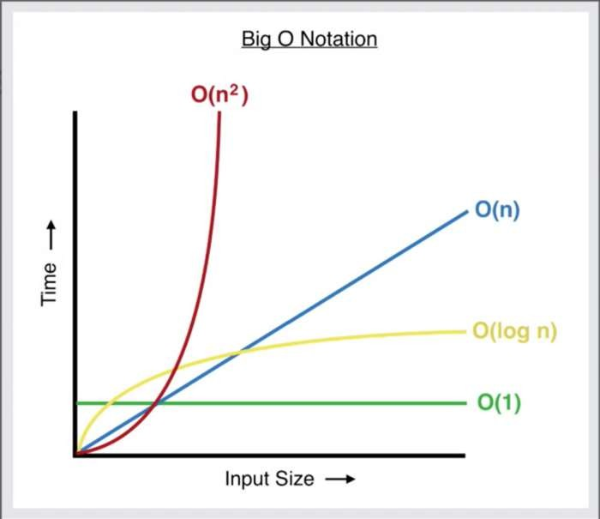
Whích is faster?

Slide 8
Thank you ☺

